Slide 1

Control Activities
Notes:
Welcome back. In the prior session we discussed what risk is and how risk assessments help to facilitate the process of identifying and assessing the risks that could prevent us from achieving our objectives. Once the risks have been identified and assessed, then control activities should be implemented to help mitigate these risks going forward. In this session we will provide a brief overview of what control activities are and how they are important to our Internal Control Program here at SUNY.

Slide 2



What Are Control Activities?
Always keep about this distance between text and the edge of slides and other content.
Control Activities are the ACTIONS established through policies and procedures that help ensure that management’s directives to mitigate risks to the achievement of objectives are carried out.
Notes:
What are control activities?
Control activities are the ACTIONS established through policies and procedures that help ensure that management's directives to mitigate risks to achieve objectives are carried out.
Management should establish control activities that are effective and efficient and contribute to the mitigation of risks.

Slide 3
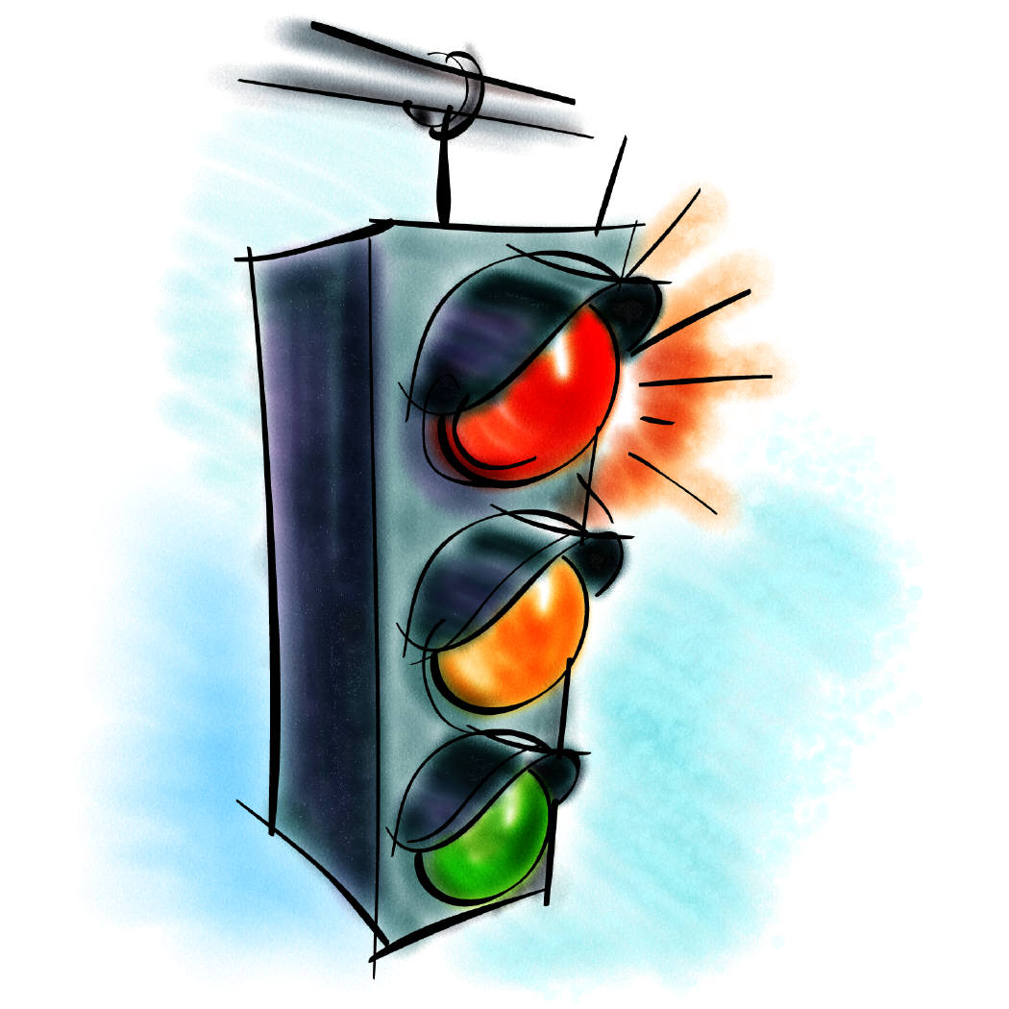
Control Activities
Always keep about this distance between text and the edge of slides and other content.
Preventive Controls
Deters the occurrence of an undesirable event
Detective Controls
Identifies undesirable events after they occur
Notes:
Control activities can be either preventive or detective.
Preventive controls are those that deter the occurrence of an undesirable event. For example, to keep unwanted eyes from seeing confidential documents, you might keep them locked in a filing cabinet.
Detective controls are those that identify undesirable events after they have occurred. A monthly bank reconciliation is a common detective control.
Many control systems have both preventive and detective attributes. Take, for example, restricting access to a facility by having employees utilize an electronic key scanner is a preventive control and having a security alarm system to identify break-ins is a detective control.

Slide 4
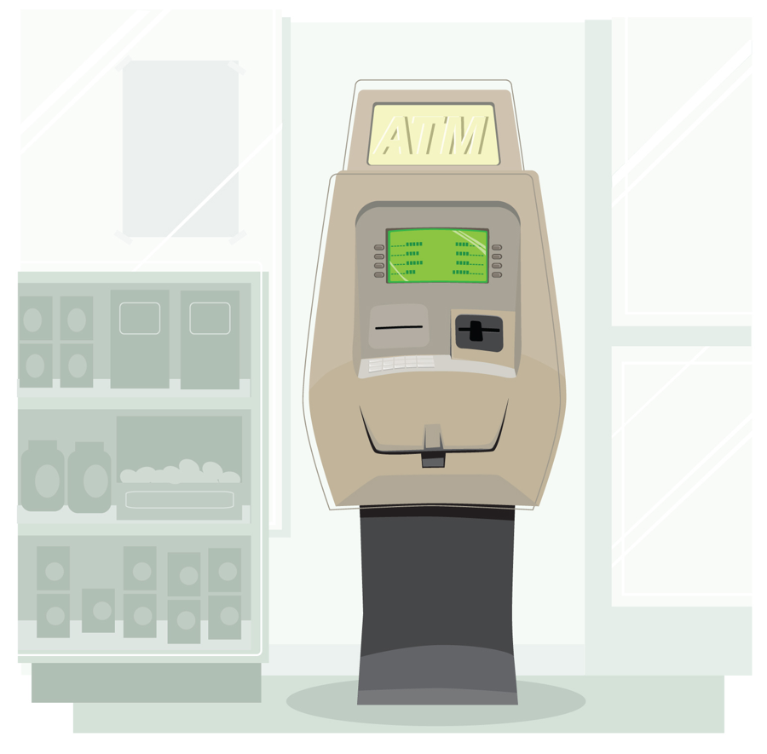


Control Activities
Always keep about this distance between text and the edge of slides and other content.
Manual Controls
Requires some action from an individual person
Automated Controls
Leverages technology to enforce internal
controls with minimal manual intervention
Notes:
Control activities, both preventive and detective, can be either automated or manual.
Automated controls leverage technology to enforce internal controls with minimal manual intervention. They increase efficiency of operations, improve accuracy, help eliminate fraud, and are a key part of a strong internal control environment. Since they work automatically, they are not subject to human errors, failure, or subjectivity.
Manual controls require some action from an individual person. These are more flexible than automated controls, but are subject to human error. Manual controls are ideal for non-automated processes that are complex or dynamic, or in places where human judgment is required.
The mix of manual and automated controls will vary with the nature and complexity of an entity’s use of IT and the degree to which processes are automated.

Slide 5
Control Activities
Always keep about this distance between text and the edge of slides and other content.
Approvals and Authorizations
Verification
Documentation
Supervisory Reviews
Separation of Duties
Safeguarding of Assets
Reporting
Notes:
Now that we have defined preventative and detective controls and noted the difference between automated and manual controls, lets discuss a little more about some frequently used control activities. As we go through, you may find them familiar and that they relate to your job function and responsibilities here at SUNY. They include:
Documentation
Documentation involves maintaining support to verify a decision or transaction includes proper review, approvals, and verification to support its validity.
Approvals and Authorizations
Approval is the consent of employee decisions, events or transactions based on a review. A manager approves a purchase request after a review and determination of the need for the item.
Authorization is the control management grants employees to carry out certain duties, based on approval received from supervisors.
Verification
Verification is the determination of the completeness, accuracy, and/or validity of transactions, events or information.
Supervisory Reviews
Supervision is the ongoing oversight, management and guidance of an activity by designated employees to ensure the work of employees are prepared accurately and completely.
Separation of Duties
Separation of duties is the division of key tasks and responsibilities among various employees and subunits of an organization. By separating key tasks and responsibilities - such as receiving, recording, depositing, securing and reconciling assets - management can reduce the risk of error, waste, or wrongful acts.
Safeguarding of Assets
Safeguarding of assets involves restricting access to resources and information to help reduce the risk of unauthorized use or loss. Access can be limited by various means such as locks, passwords, electronic firewalls and encryption.
Reporting
Reporting is a means of conveying information. A report that serves as a control activity would be one that compares purchasing activities with the approved budget, explaining significant variances between the two.

Slide 6

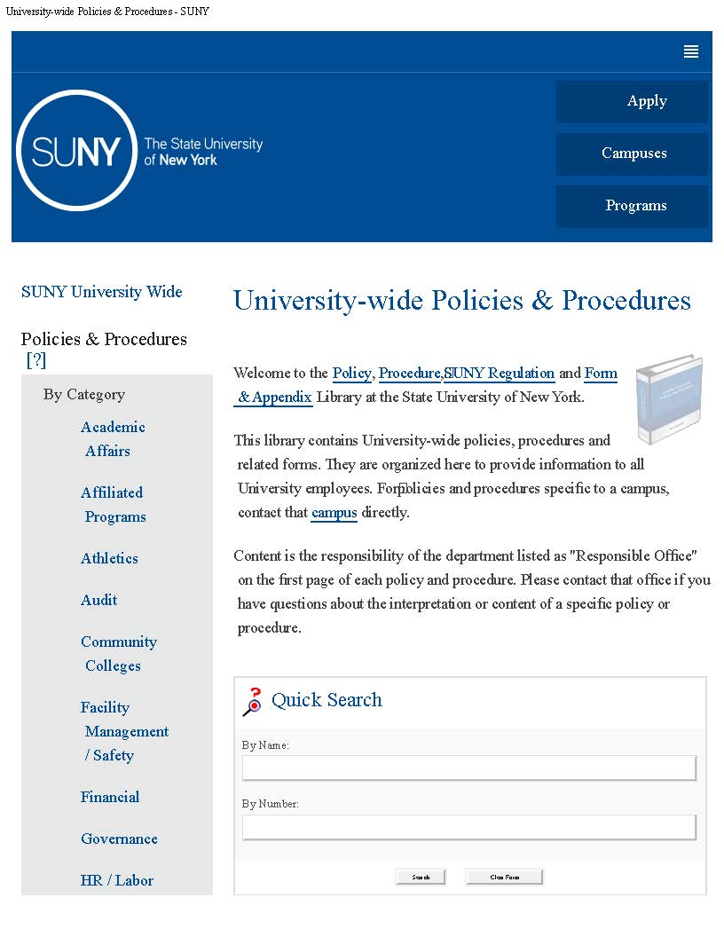
Control Activities
Always keep about this distance between text and the edge of slides and other content.
Policies specify and establish what is expected.
Procedures are the steps taken to put policies into action.
Notes:
Organizations establish control activities through policies that establish what is expected and procedures that put policies into action. Policies and procedures help ensure employees understand their responsibilities, uphold staff accountability, and assist with staff transitions. They should be distributed and made readily available to the appropriate employees, and reviewed and updated periodically, as necessary.
Here at SUNY we have University- wide policies and procedures, which can be located on our SUNY website, that contribute to the mitigation of risks to achieve SUNYs objectives. These include such areas, as Procurement, Property Control, and Financial Operations, to name just a few.
In addition to University wide policies and procedures, campuses and individual departments and functional units should develop written policies and procedures specific to their operations dependent upon the nature and complexity of the operation.

Slide 7
Questions?
Thank You!
Created by the Office of the University Controller, SUNY System Administration
Notes:
This concludes our presentation on control activities. Thank you for your continued support in helping maintain effective internal controls. If you have any questions or comments, please contact your Internal Control Officer.

